Slide 2
Acknowledgements
This document reports on work funded by the United States Agency for International Development, under a USAID Southern Africa grant – RFA-674-12-000016 RESilience in the LIMpopo Basin Program (RESILIM). The RESILIM-O part of the programme is implemented by the Association for Water and Rural Development (AWARD), in association with project partners.
Authors
Bigboy Mkhabela
2019
Association for Water and Rural Development (AWARD)
P O Box 1919
Hoedspruit 1380
Limpopo, South Africa
T 015-793 0503
W award.org.za
Company Reg. No. 98/03011/08
Non-profit org. Reg. No. 006 – 821

Slide 3
Linah Malepe [Sedawa Community Mopani District]
Introduction
The focus of most backyard gardeners or smallholder farmers is planting vegetables in their gardens for resale or subsistence. They are selling their produce to locals or big shops in town or certain targeted markets. Due to the climate change challenges, some farmers want to venture into farming edible or medicinal herbs in their gardens. One of the reasons is that most of the herbs are hardy and can withstand current unpredicted weather changes.
Different types of herbs were introduced in the communities and the majority of the farmers now know their uses and some have a market for them in neighbouring towns. However more training and information on the uses of herbs are needed, hence some of the farmers asked us to compile a booklet on herbs so that they can easily remember their benefits and be able to train other farmers on the use of herbs.
Comments follow from some of the farmers in the middle to the lower Olifants who are pioneer herb growers. Many of the photos in this resource come from their gardens.
“We all want to save as much as we could under this economic challenges in our country. Herbs are very easy to grow and they do not require a huge effort and space. Herbs can be expensive to buy when buying them in big shops that is why I prefer to grow them. I enjoy being in the herb garden and it also helps me to relax and refresh my mind. I take care of my family - their health is my first priority. Planting my own herbs gives me assurance that I’m getting 100% organic herbs and fresh crops. Fresh herbs can help to relieve stress, high levels of cholesterol in our bodies and they can help with the digestive system. It give us more chances of not getting cancer as well. My husband will mostly certainly agree with me on this one.”

Slide 4
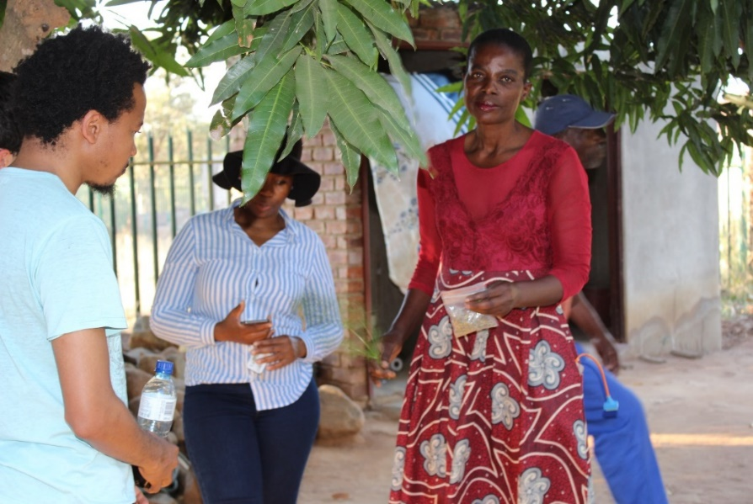
Anna Molala [Capricorn District from Zebediale Village]
Christina Thobejane [Sedawa Community, Greater Mametja Area]
“I planted herbal plants in my garden because it helps me and my family to cut cost on buying spices. Some of the herbs are for medicinal purposes. I make herbal tea with them and drink with my family. I also share with the community - they enjoy using them and I have introduced herbs when they buy vegetables from my garden. Herbs keep my body active and healthy that is why I look very young … As a farmer it is a must to have herbs in the garden as they help in controlling pests. I do not buy pesticides to control pests. This saves money for me and the environment as anything I plant and produce is organic because of the herbs.”
“The herbs help make our food delicious and also can heal some minor pains and diseases. They are important because they help to control pests and diseases in our gardens, the smell of the of herbs help to repel things like mosquitoes and snakes. They also provide income for the family and we can make ends meet at the end of the day. Having a herb book will help the community to learn more about the important of growing herbs.”

Slide 5
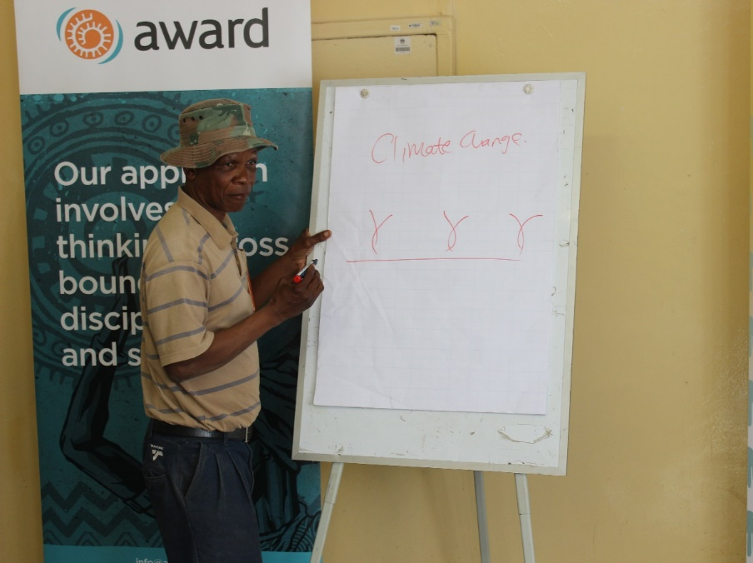
Joel Mahlangu [Monsterlus, Sekhukhune District]
Peter Tsokela
[Motetema, Sekhukhune District]
“Herbs are organic plants and are useful to the body. I use them in the kitchen as spices e.g. parsley for fish, rosemary for lamb stew. Having herbs in the garden is like having a pharmacy in my own yard. If a family member get sick I know which herbs to use and for what purposes; an example is if someone has flu I can prescribe lemon grass, mint, thyme, ginger, wild dagga .Lemon verbena is for high blood pressure and celery can help me and my family to live a good life. Herbs are key for one’s well-being. They save money; we need less consultation to medical practitioners and more healthy living.”
“I have planted diverse herbs ranging from rosemary, lemon verbena, coriander, parsley, and okra etc. The reason I have all this different types of herbs is that they are essential to our lives, when we combine certain types of herbs and boil them they become remedy for flu, basil chases away insects and also restores oxygen in the house. Okra can help sin improving the immune system in our bodies.”

Slide 6
African Wormwood / Lengana
Wormwood is a herb. The leaves, stems & oil can be used as medicine for various conditions.
Mahlare le makhura a moṥunkwane wo ba rego ke wormwood a šomišwa go alafa malwetše
Medicinal uses and health benefits are summarized below:
Treat gallbladder disorders / E fodiša malwetši a sankila
Control excessive sweating / E okeletša kudumelo
Treat indigestion / E thuša tšhilego ya dijo
Ease insect bites / E fodiša mabadi ge o lomilwe ke dikhunkhwane
Assist with loss of appetite / E dira gore o kganyoge dijo
Assist with low sexual desire / E Thuša ka go tsoṥoloṥha kganyogo ya thobalano
Relieves spasms / E kgona go thuša ge otshwara ke boedidi
Treats worm infestations / E bolaya diboko
Treatment of wounds / E fodiša dintho /dikgobalo
A certain kidney disease called IgA nephropathy / E lwantšhana le malwetši a mangwe a dipṥhio a bitšwago lgA nephropaphy

Slide 7
Aloe Vera / Sekgopha / Kgopha
Medicinal uses and health benefits are summarized below:
Aloe vera is most commonly used as a topical medication, rubbed onto the skin rather than eaten. It has long been known as a treatment for sores, particularly burns, including sunburns / Sekgopha/ Kgopha e šomišwa kabontšhi bjale kasehlare lego dira delo tšagoke bafatša, Sekgopha setšebega kabontšhi kago kalafa dintho kudu kudu geoswile lege o fišetše kelitšatši
Applying Aloe vera to burn wounds appears to accelerate the healing process / Geo tlotša sekgopha mo o sweleng gone e bontšha e akgofa go fola
Tooth decay and gum diseases are very common health problems. Aloe vera mouth rinse was found to be just as effective in reducing dental plaque build up as chlorhexidine in regular mouthwash / Sekgopha se Thuša go lwešana le malwetši / hlaselago meno goba go bola ga meno. Go šomiša Sekgopha go hlwekiša Meno e Thuša kudu monkgo / Wa molomo
Applying Aloe vera, either as a patch or gel, has been shown to aid in the recovery of mouth ulcers (canker sores) / Go bea Sekgopha/ Kgopha keletlakala goba meets a gona e bontšha e Thuša go alafa dintho ka molomong
Aloe vera latex has strong laxative effects, making it useful to treat constipation. It does not appear to be beneficial for other diseases of the digestive tract / Sekgopha/Kgopha e kgona go tšhuloša eo e thušago ge onale bothata bjago tlalelana kadi mpeng
Early evidence suggests that Aloe vera may help with blood sugar management / Go šomiša Sekgopha/Kgopha e Thuša golawola bolwetši bja swekere
Arthritis: Osteoarthritis is common in elderly people and is a condition in which the cartilage in the joints wears away, inducing pain and stiffness mainly in weight-bearing joints. Rheumatoid arthritis affects the whole body and not only certain joints. It is an inflammatory disease and joints become inflamed. Aloe vera assist sin treating both conditions / Bolwetši bja makopantšho adi khuru di hlasela gantšhi batšofadi /motšofe. Di khuru dia lapa di dira guri batšofi bapelele kego Tsamaya lebo hloko makopantšhong. Bolwetši bjo gabo hlaseli di khuru fela impa bohlasela mmele kamoka. Ke bolwetši bjago ruruga dikhuru le Makopantša mo mmeling
Aloe vera is a thick, short-stemmed plant and is well recognised by its thick, spear shaped and fleshy green leaves, which can grow to about 30-50 cm in length. Each leaf is full of a slimy tissue that stores water, which gives the leaves their thickness. This slimy tissue is the "gel" we associate with Aloe vera products. The gel contains most of the bioactive compounds in the plant, including vitamins minerals, amino acids and antioxidants. It is widely used in the cosmetic, pharmaceutical and food industries.
Sekgopha enale letlalo lelekoto leo mošomo walona kego swara meets. Lefasing kabophara e šomišwa bjala dihlare,Dijong, makhura.

Slide 8
Basil
Basil is a common name for a culinary herb Ocimum Basilium. It belongs to the mint family and is also known as Saint Joseph’s Wort in English speaking countries. It has been called the “king of herbs” and the “royal herb”. The word ‘basil’ comes from the Greek word basileus meaning the king. It was also said by an herbalist named John Gerad that people stung by a scorpion would feel no pain if they ate basil. This herb has its roots in India and Iran and these lands have been cultivating it for more than 5 000 years.
Basil ke semela sa go wela ka legorong la di mint ebile e bitšwa kgoshi ya ditlama. Lebitšo goba leina le la basil ka seGerike le emetše gore kgoshi. Go thwe ge motho a ka longwa ke phephene a ka se kwe bohloko ge a ka ja yona basil. moṥunkwane se se na le dikitikiti tsa mengwaga se bjalwa nageng tša Iran le India.
Medicinal uses and health benefits are summarized below:
Basil e thuša ka go okobatša go ruruga le dingalo tša marapo. Basil e ka nwegwa bjalo ka tee go alafa malwetši a go fapafapana:
Ease inflammation / E thuša lego fokotša bohloko le go ruruga
Relieves joint pain / Bohloko bja malokololo
Relieves stress / E lwesana le kgatelelo ya monagano

Slide 9
Cancer Bush/ Lerumo-lamadi
Cancer bush (Sutherlandia Frutescens) originates in Southern Africa and it is distributed widely in South Africa, Botswana and Namibia. In South Africa, the plant is found in the Northern Cape, Eastern Cape, KwaZulu-Natal, Western Cape and Mpumalanga provinces.
Lerumo lamadi le mela ebile le humanega dinageng tṥe mmalwa mo Afrika elego Namibia, Botswana, le Africa Borwa. Ka mo Afrika Borwa le humanega diprofinsing tṥe: Kapa Leboa, Kapa Mohlabatṥatṥi, Kwazulu – Natal le Mpumalanga
Medicinal uses and health benefits are summarized below:
Mehola wa Lerumo-la madi ka kakaretṥo ke e latelago:
Treatment of internal cancers / E thuša go lwešana goba go laola bolwetše bja Kankere
Colds, ‘flu’ / E thuša go lwešana le mpshikela goba mokgohlane
Asthma / E thuša go lwešana goba go laola bolwetši bja mafahla goba yona asema
TB / E thuša go lwešana le bolwetši bja mafahla
Rheumatoid arthritis pain / E fokotša bohloko bja bolwetši bja marapo
Osteoarthritis / E thuša go lwešana le bolwetši bjo šoro bja marapo
Liver problems / E lwešana le malwetṥe ao a hlaselago Sebete
Bladder and uterus problem / E fodisha malwetši a sankila le mathata mabapi le popelo
Diarrhoea / E thuša ka go laola letšhologo/teng
Dysentery / E thuša go laola teng khwibidu

Slide 10
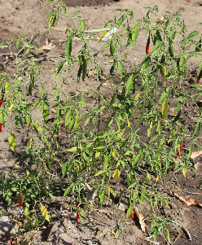
Chilies
Medicinal uses and health benefits are summarized below:
Chili pepper contains an impressive list of plant derived chemical compounds that are known to have disease preventing and health promoting properties / Perefere e na le di khemikhale tšeo di tšhireletšago malwetši
Chilies contain a health benefiting alkaloid compound, capsaicin, which gives them a strong spicy, pungent character. Early experimental laboratory studies on mammals suggest that capsaicin has anti-bacterial, anti-carcinogenic, analgesic and anti-diabetic properties. It has alsobeen found to reduce LDL cholesterol levels / Perefere e na le capsaicin yeo e thušago go fokotša makhura a go tliṥa mmele
Fresh chili peppers, red and green, are a rich source of vitamin-C. 100 g fresh chilies provide about 143.7 µg or about 240% of RDA. Vitamin-C is a potent water-soluble antioxidant. It is essential for the collagen synthesis inside the human body. Collagen is one of the main structural proteins required for maintaining the integrity of blood vessels, skin, organs and bones. Regular consumption of foods rich in vitamin-C helps protect from scurvy, develop resistance against infectious agents (boosts immunity) and remove harmful, pro-inflammatory agents from the body / Perefere ye tala le ye hwibidu e la Vithamini C. Go fepa mmele ka dijo tṥa go ba le di vithamini C go thuṥa ka go aga maṥole a mmele
They are also rich in other antioxidants such as vitamin-A, and flavonoids like β-carotene, α-carotene, lutein, zeaxanthin, and cryptoxanthin. These antioxidant substances in capsicum help protect the body from the effects of free radicals generated during stress and diseases / Perefere e fepa mmele ka vithamin A le tṥe dingwe dijo tṥa go lokela mmele
Chilies carry a good amount of minerals like potassium, manganese, iron, and magnesium. Potassium is an important component that helps control heart rate and blood pressure. The human body uses manganese as a co-factor for the antioxidant enzyme, superoxide dismutase / Perefere e swere di minerale tṥa go wana potassium, manganese, aene, le magnesium. Potassium e bohlokwa e thuša go laola sepediṥo ya madi ka mo pelong gore e heme botše le gatelelo ya madi

Slide 11
Comfrey
The common comfrey plant is known in Latin as Symphytum officinale and displays a “hairy” exterior. It grows as a root stick with branches coming from the stalk and only gets to about 2–3 feet tall. Some varieties produce yellow or purplish flowers alongside the broad, fuzzy leaves. The most commonly grown species is Russian comfrey (Symphytum x uplandicum) which might have a healing effect and reduce inflammation when applied to the skin. However, comfrey contains toxic chemicals that can be absorbed through the skin.
Semela se ka se Latin se bitšwa gore ke symphytum officinale. Matlakala a semela a na le likaroloana tša dinthla tša go emelela. Semela se ge se feleletše ka sebopego se ka fihla metara o mo tee. Matšoba a semela se a na le mebala e mebedi elego serolwana le pherese. / Dikhemikhale tšeo di lego ka gare ga Comfrey di fokotša go roroga ge o tlola letlalong lagago
Medicinal uses and health benefits are summarized below:
Comfrey is used as a tea for upset stomach, ulcers, heavy menstrual periods, diarrhoea, bloody urine, persistent cough, painful breathing (pleuritis), bronchitis, cancer and chest pain (angina). It is also used as a gargle for gum disease and sore throats / Comfrey e ka nwewa bjale ka tee go thuša ge bofokodi ele letšho/llo, ge motho a rota madi (mohlapo), go alafa mogohloane, sehuba, bohloko bja kgara, le go lweṥana le bolwetṥi bja kankere. Semela se sa ka šomišwa gotšokotša legano ge onale bothata bja go tswa madi gape se ka tuša megolo ye bohloko
Comfrey is applied to the skin for ulcers, bruises, rheumatoid arthritis, swollen veins (phlebitis), gout and fractures / Comfrey e ka tlolwa ge o na le bothata bja seokelelo, ge o rorogile, o robegile ditho tṥa mmele le ge o swenya le bolwetṥi bja marapo goba gout
The chemicals in comfrey can quickly relieve muscle and joint pain or inflammation / E thuša kudu ka bohloko bja meshifa le dijoin
Effective for lower back pain relief / E Thuša kudu ge o kwa bohloko mokokotlong
Natural fibromyalgia remedy
Speeds up wound healing / E thuša go fodiša dintho ka pele
Lessens skin irritations / E fokotša gohlohlonya ga letlalo

Slide 12
Coriander
Coriander is believed to be derived from the Greek word koros which means insect and koriannon, meaning bug. The specific name refers to its cultivation in gardens. Taken together, the full scientific name calls coriander ‘the cultivated buggy-smelling’ plant.
Go thwe leina le la Coriander le tšwa lelemeng la Bagerike lona le emetše kokonyane goba khungkhwane. Semela se se theilwe go ya ka tšhomišo sa sona ka di tshemong.
Medicinal uses and health benefits are summarized below:
Coriander is used for digestion problems including: / Coriander e thuša ka tšila ya dijo ka mpeng/maleng
Upset stomach / Ge o tshwenya ke mala goba ge ka maleng osa thaba
Loss of appetite / E buša tumo ya dijo
Hernia, nausea / Ge go selekega
Diarrhoea / E fodiša letšhologo/teng
Bowel spasms / E thuša go laola bohloko ka maleng
Intestinal gas / E fokotša moya ka maleng
Used to treat measles / E alafa mmoko
Toothaches / E fodiša bohloko bja meno
Worms / E bolaya dinogana ka maleng
Infections caused by bacteria and fungus / E lwana le malwetši a go hloka ke pakteria goba ditjwatši
Some breast-feeding women use coriander to increase milk flow / E thuša go oketša lebese ka nako ya go nyantšha
In food, coriander is used as a culinary spice and to prevent food poisoning / Ka dijong e šomišwa bjalo ka spice gabedi le go bolaya mpholo wa dijo

Slide 13
Dandelion
A dandelion is a flower and is also a broad term for many types of flowers that are native to Europe and North America. Taraxacum is the large genus to which these plants belong. They are herbaceous and perennial plants that grow very well in temperate climates. They also reproduce quickly and effectively, so it is possible to cultivate plenty of dandelions at the same time. Interestingly, dandelion translates into “lion’s tooth” in French.
Dandelion e akaretṥa matṥoba a mmalwa a go humanega lefaseng ya Europa le Amerika Lebowa. Semela se se gola ka pela ebile se enya ka morago ga nako ye kopana. Ka se French lebitṥo la semela se le emetje gore meno a tau
Medicinal uses and health benefits are summarized below:
Improve bone health / E Thusa ka go tiiṥa marapo
Treat liver disorder / E lwešana le malwetsa ao a hlaselago sebete
Control diabetes / E kgona go laola bolwetse bja swikiri
Treat urinary disorders / E thuṥa ka malwetši a mohlapologo
Skin care / E hlokomela letlalo
Prevent acne / E thibela dišo
Weight loss / E Thuša go fokotsa Mmele
Prevents cancer / E Thibela bolwetši bja Kankere
Regulates blood pressure / E lwešana le madi a magolo

Slide 14
Dill
Botanically known as Anethum graveolens, dill belongs to the same family as parsley and celery. It is native to the eastern Mediterranean region and western Asia. The word dill comes from the Old Norse word dylla, meaning to soothe or lull. It dates back in writing to about 3000 B.C.
Medicinal uses and health benefits are summarized below:
Digestion - Dill is considered to be a carminative, meaning that it can help to calm and relieve intestinal gas / E thuša ka ge o tletše moya ka teng
Colic - You might consider adding a container of dill to the gift you give to a new mom, as a weak tea, made from dill seeds and water, can help ease colic as well as get rid of hiccups and promote sleep for infants. Dill also promotes lactation in nursing moms / E thuša masega go robala le ge o na le setheku. E thuša o oketša matutu/mekgato batswetšing gore ba kgone go nyantšha
Bone Health - Just a tablespoon of dill seeds contains as much calcium as one-third of a glass of milk. This helps protect you from bone loss and also makes an excellent source of calcium for vegans and people who are allergic to dairy / E tiiša marapo - E fepa mmele ka khalsium. Lelepole le tee la peu ya dill e lekana le khalsium ya go tswa seripana sa kgalase ya lebese
Insomnia - The essential oils in dill are quite unusual as they are both stimulating and sedative at the same time / Go hlobaela
Respiratory issues / E thuša ge onale bothata bja go hema

Slide 15
Fennel
Fennel (Foeniculum vulgare) is an aromatic herb that originated in the Mediterranean region and has many culinary and medicinal uses. It has not been spread and naturalized as an herb around the world, but still primarily grows in coastal climates and on riverbanks. It is also one of the main components of the alcohol absinthe, although the plant does not have hallucinogenic properties.
Semela sa Fennel ke senkgabose seo se tšwago dinageng tša Maditerranen. Yona e šomišwa bjalo ka sehlare. Fennel ka tlhago e mela mafelong a go ba kgauswi le mawatle le dinoka.
Medicinal uses and health benefits are summarized below:
Treat ingestion / E lwa lego swagana ga mala
Treat constipation / E fodiša go bipelwa
Reduce heart doseases / E fokotša malwetši a pelo
Prevent cancer / E Thibele bolwetše bja kankere
Regulates blood pressure / E kgona go laola madi ge a le godimo goba fase
Boost immunity / E fepa Mašole a mmele
Regulate menstruation / E thuša go laolsa tshepedišo ya madi ge basadi ge ba le matšatšing

Slide 16
Geranium / Jerenum
Medicinal uses and health benefits are summarized below:
Adrenal health – Geranium has been used for centuries for its ability to support the adrenal glands. It acts as a tonic for the paired adrenal glands that sit atop the kidneys. In so doing, geranium may help those suffering from chronic exhaustion and fatigue / Jerenum ke kgale e ṥomiṥwa dikiti tṥa mengwaga go alafa dithaka tṥa go dula ka godimo ga dipshio.
Eases allergies , anxiety, depression, nervous tension / E thusa go laola kgatelelo ya monagano le letṥhogo
Regulates blood sugar / E lwešana le bolwetši bja swikiri
Boosts brain clarity & concentration / E kgona go thuša gore o nagana botse lego tsitsinkela
Cancer treatment – Geranium has long been used by natural healers for its anti-tumoral properties / Ke kgale e šomišwa ke dingaka tša setšo go lwantšha Kankere
Hair and scalp health – Geranium has been used traditionally for decades for hair regrowth / E be e šomišwa go godiša meriri ka nako ya kgae
Insect repellent – Bugs don’t like geranium! It is an excellent insect deterrent / E koba dikhunkhwane
Skin health, scars and regeneration / E thuša go tloša mabadi le gompšafatša letlalo

Slide 17
Lemongrass
Medicinal uses and health benefits are summarized below:
Relieves menstrual pain / E thuša go okobatša selomi ge basadi ba le matšatšing
Treats cold and flu / E fodiša mokgohlwane
For naturally great skin and hair / E Thuša letlalo le meriri gore e phadima e be e me botse
Boosts metabolism and burns fat / E hlasela makhura ago nontšha lego thuša gore teng e kgone go šila dijo
Regulates high blood pressure / E laola madi a magolo
Full of antioxidants / E fepa mmele ka dijo tse botse
Good for digestion / E Loketse tšhilo ya dijo

Slide 18
Lemon Verbena
Lemon verbena is a lovely aromatic plant that is indigenous to South America. It was brought over to Europe by the Spaniards. It has been used widely as a culinary herb, and as a tea. It was also used as a perfume and it is known for its medicinal properties.
Lemon Verbena ke semela sa go tšwa Amerika Borwa. E fihlile Europa ka lebaka la ba eti ba go tšwa nageng ya Spain. E šomišwa kudu mo dijong gabedi ka dinwamapodi. E na le go šomišwa bjalo ka setlolo le go alafa malwetsi.
Medicinal uses and health benefits are summarized below:
Treating pain, fever and asthma / E lokete go alafa dingalo tsa mmele,bolwetsi bja asema
It is used for making perfumes and herbal tea / Le go dira ditlolo le tee. lemon Verbina e dira ledi phefume
Lemon Verbena is a stomachic and therefore good for relieving indigestion, heartburn and for tonifying the digestive tract / Lemon verbena e thuša go alafa go bipelwa, sekgokolela le hlwekiša madi mmeleng
It is also great for soothing anxiety and as a sedative it is helpful in insomnia / E thuša ka go tloša maikotlo a manyami goba letšogo, gape e thuša gape le bao beo le bothata bja ose sware ke boroko
Lemon balm is a febrifuge and is indicated for use in reducing fevers. It’s also gentle in its action and thus safe to use with children and the elderly / E thuša go alafa phišo, le go thuša ka o kgona robala

Slide 19
Marigold
Medicinal uses and health benefits are summarized below:
For ingestion, combine marigold blossoms with warm water to create a calendula tea / Letšoba le la Marigold le thuša ge osa sohle botše dijo goba go swenya kudu ke teng. Kopantšha letšoba le meetse a borutho go dira tea
Marigold is generally known as the herb to address cuts, sores and general skin care. For this purpose, marigold compares with other Hildegard healing herbs, including yarrow and violet / Letšoba le la Marigold le tšebega bjale ka moṥunkwane wa go alafa dišo, le malwetṥi a letlalo ka kakaretṥo
They act as anti-inflammatories to promote topical healing and soothe irritated skin. Topical treatment with a diluted marigold solution or tincture accelerates healing of wounds and rashes / Letšoba le la Marigold le thuša ge onale letlalo la go hlohlonya goba la go ba le diṥo
DIY Marigold Ointment (Calendula cream) / E ka ṥomiṥwa go dira dilo tṥa go tlola
To make homemade marigold cream, take flower heads in whole without removing any parts. Shake out the whole calendula flower heads upside down on a kitchen towel to remove any small insects. Do not wash. Heat olive oil in a sauce pan and insert marigold flowers to cover with oil. Allow 24 hours to steep in oil and then strain and save the oil. Heat the oil again, add 10 grams of beeswax per 100 milliliters of marigold oil combination and allow the combination to melt / Go dira setlolo ka Letšoba le la Marigold, tšea hlogo ya letšoba koafela, tšhokotša hlogwana e ya letšoba oe lebantšhitšhe fase gore dikhunkhwane di tloge. Letṥoba le sa hlatswa. Makhura a Olive a ruthufatṥwe ka gare ga pane pele matṥoba lokelwe gare ga pane. Ka morago ga di iri tṥa go lekana letṥatṥi matṥoba a tloṥwe ka gare ga pane. Makhura ao ṥala a ruthufatṥwe gabedi
Marigold plants contribute to the overall well-being of any vegetable garden. In Germany, marigolds serve as a symbol of the organic gardener. Calendula contributes to the garden through an extensive root system that exudates and enriches the surrounding soil. As a mixed culture partner, it is compatible with all kinds of vegetables and herbs. Despite its prolific growth, marigold is easily managed, and can be converted to mulch for the vegetable bed / Letšoba le la Marigold e thuša gore dimela le dibjalwa di phele gabotse ka tṥhemong. Nageng ya Germany (Jeremane) ge gonale letšoba la Marigold ka tṥhemong go laetša gore ke wena molemi wa tlholego. Letšoba le la Marigold le thuša go nontṥha mobu ka medu ya yona. Letšoba la Marigold le a laolego ga mmogo le ka ṥomiṥwa go oketṥa tṥhireletṥo ya mobu

Slide 20
Mexican Poppy
The Mexican Poppy, or Argemone mexicana, is a white-yellow flowering plant, called “food of the dead” by the ancient Aztecs and sacred to their rain god Tlaloc. It was introduced from Mexico long ago to China and is now growing wild in Xishuangbanna. It’s now widely naturalized in the United States, India, and Ethiopia.
Mexican poppy e bitšwa gore ke “dijo tṥa bahu”. E tṥwa nageng ya Mexico eupša e humanega mafeseng a China, United States, India le Ethiopia, Africa Borwa.
Medicinal uses and health benefits are summarized below:
Treat skin problem / E alafa malwetši a letlalo
Heal wounds / E fodiša mabadi
Mosquito repellent / E koba menang
Impotency / E thuša bao palelwa ke go ba le bana
Ringworm / Ea alafa ge o tṥwile ke dipudi
The extract of fresh seeds is helpful for herpes sores, warts, skin infections, itching, skin diseases, jaundice and dropsy / Meets a go tṥwa peung ya Mexican poppy a bohlokwa go alafa malwetṥi a letlalo, dintho le mamokebe.

Slide 21
Mint
Mint leaves can refer to any plant in the Mentha genus, but the term is most often used to refer to peppermint and spearmint, the two most common types of mint plant. Spearmint is a plant with a sweet flavour that works well in many recipes while peppermint has a higher concentration of menthol, which accounts for many of the medicinal uses of mint leaves.
Legoro la menthe genus le akaretša matlakala a fapafapanego a semela sa mint. Peppermint le spearmint ke dimela tše pedi tša go bitšwa mint. Dimela tse di šomišwa ka dijong gabedi le go alafa malwetši.
Medicinal uses and health benefits are summarized below:
Improve digestive health / E thuša mala gore a šile dijo botše
May relieve cold symptoms / E kgona go lwantšha mokome
Assist in oral hygiene / E thuša go hlwekisha legano
Boost brain function / E fepa bjoko kadijo gore bo bereke botse
Soothe breastfeeding pain / E thuša go alafa bohloko bja ge mosadi a nyantšha
Decrease indigestion / E thuša gose šilege botše ga dijo

Slide 22
Rocket
Medicinal uses and health benefits are summarized below:
Rocket is rich in vitamin K (contains 109mg per 100 grams) which promotes a healthy heart, bones and skin. Vitamin K regulates blood clotting so that your injuries heal when you get hurt. It also helps regulate blood pressure for a healthier heart and ensures calcium is carried to your bones / Rocket e fa mmele Vithamin K. E thuša ka fihliša Khalsium marapong. E loketše pelo. Vitamine K e thuša gore madi a sepele botše mmeleng legore ge o gobetša o phakiše o fole. E thuša gore madi a magolo ( High blood pressure) a laolege
Boost eyesight with rocket. Two antioxidants, lutein and zeaxanthin, are found in rocket. These antioxidants protect the macula of your eye from degeneration. They also guard against damage caused by UV light and blue light / Rocket e thuša ka go kaonafatša pono.) Rocket e šireletša mahlasedi a letšatši (UV) gore esa gobatše mahlo
Protect against cancer. Like other cruciferous vegetables, rocket contains glucosinolates which are broken down into powerful compounds in the body. These compounds protect your cells from damage and have been shown to inactivate cancer cells / E thusa ka thibelo ya kankere

Slide 23
Rosemary
Rosemary is a fragrant evergreen herb native to the Mediterranean. It is used as a culinary condiment, to make bodily perfumes and for its potential health benefits.
Rosemary ke moṥunkwane wa go ba le mongko w bose. Rosemary ka tlhago e tswa nageng tṥa go wela go Mediterranean. E šomišwa go dira ditlolo gape e na le mohola mmeleng.
Medicinal uses and health benefits are summarized below:
Antioxidants and anti-inflammatory compounds / E tuša ka go lwešana le ditwatši mmeleng ga mmogo le go fodiša
Improving digestion / E hlohloletša tšhilego ya dijo ka maleng
Enhancing memory and concentration / E thuša monagano go tsepamiše kgopolo
Neurological protection / E thuša ka go šireletša megala-tšhika
Prevent brain aging / E šireletša go tšofala bja bjoko
Cancer / E lwešana le bolwetši bja Kankere
Protection against muscular degeneration / E thusa ka tšhireletšo ya mešifa
Heartburn, peptic ulcers / E laola seokelelo le dišo tša ka teng
Backache / E thuša go fokotša bohloko bja mokokotlo
Diabetes / E Lwešana le bolwetši bja swikiri
Treatment of mental and emotional stress / E thuša monagano gore go otlolloge

Slide 24
Sourfig (Yellow flower)
Carbobrotus edulis / Sourfig is indigenous to the Western Cape Province in South Africa. Today it is grown all over the world. It is a fleshy, succulent mat-like creeper bearing large yellow flowers followed by conical, reddish-brown, fleshy fruit capsules. Is drought tolerant and will do well in sun or partial shade.
Sourfig e humanega mo Afrika Borwa Kapa Bodikela. Mehleng ya lehono e bjalwa lefaseng ka bophara. Ke semela sa manoni sa go ba le matṥoba a serolwana. Setshwarapeu sa wona sebopegile go swana le dikhouno. Semela se se kgotlelela komelelo ka go boloka meetse ka gare ga dikalana sa sona
Medicinal uses and health benefits are summarized below:
It is said that the leaf pulp and juice contains tannins / Letlakala la Carbobtrotus le na le tannins yeo e ṥomago go go fepa mmile kadi antioxidant .
Antiseptic, antibacterial, anti-fungal / E kgahlanong leditwatši
Vasoconstricter effect - reduces fluid loss from wounds and burns / E fokotša gofela ga meetse mo dišong le dinthong tṥa mollo
Enhances tissue regeneration / E mpšafatsa mašole a mmele
Apply pulp/juice for treatment of eczema, wounds, burns and to stop bleeding / Tlotša meetse a yona mo dinthong go emiša madi
Gargle - infections mouth/ throat / E tšokotšwa ka ganong go bolaya ditwatši
Treat ear/tooth ache and oral and vaginal thrush / E fodiša ditsebe,leino,legano le malwetsi setho sa basadi sa go ithuṥa
Chew and swallow juice to treat mouth/stomach ulcers, dysentery, digestive troubles, diarrhoea, tuberculosis, diuretic and styptic / Moṥunkwane wo o ka sohlwa ya ba ya metšwa go fodiša seokelelo ka mpeng,bothata bja tšhilo ya dijo,letšhologo Le Kankere
Rub juice against a babies gums when teething / E tlotṥiwa marinining a ngwana ge a thoma go meno.

Slide 25
Stinging Nettle
Stinging nettle plant, scientifically known as Urtica dioica, is one of the six sub-species within the Urtica genus. The native range of stinging nettle, also known as common nettle in some places, is extensive, including Africa, Europe, Asia, and North America. Stinging nettle root and leaves have different medicinal properties. Stinging roots can be taken as a tea, tincture, extract, capsule or pill.
Semela se se humane mafeseng mmalwa go swana le Africa, Europa, Asia le America Lebowa. Medu le mahlare a semela se a na le mehola e mmalwa ka go alafa. Medu ya semela se e somišwa go dira diokobatše, mafura a sona a somišwa le gona se ka nwega ka tee go alafa mmele.
Medicinal uses and health benefits are summarized below:
Treat skin problem / Alafa malwetši a letlalo
Mosquito repellent / E koba menang
Impotency / E thuša bao palelwa ke go ba le bana
Ringworm / E thuša go alafa dipudi tṥa go tṥwa batho mo mmeleng
Bleeding / E thuša go laola madi tṥhologo ya madi morago ga dikgobalo
Diabetes / E lwantšha bolwetši bja swikiri
Anemia / E thuša ka go oketṥa tlhaelelo e kgolo ya madi mmeleng
Poor circulation / E thuša gore madi a sepele gabotse
Diarrhoea / E laola letšhollo
Asthma / E laola bolwetši bja asema
Cancer / E lwantṥha bolwetṥi bja kankere
Wound healing / E thuša go fodiša dintho

Slide 26
Thyme
Thyme is a Mediterranean herb with dietary, medicinal, and ornamental uses. The flowers, leaves, and oil of thyme have been used to treat a range of symptoms and complaints.
Medicinal uses and health benefits are summarized below:
Kills tiger mosquitos, native to tropical and subtropical areas of Southeast Asia / Semela se šomišwa go bolaya menang
High blood pressure / E fokotša madi a magolo
Foodborne bacterial infections: thyme oil, even at low concentrations, has showed potential against several common foodborne bacteria that cause human illness / Makhura a thyme a kgona go thibela malwetši a go hlola ke dijo tša go se apeiwe gabotse goba tša go bola
Thyme oil and lavender oil: thyme oil has been noted effective against resistant strains of Staphylococcus, Enterococcus, Escherichia and Pseudomonas bacteria / Makhura a semela sa thyme ana le mohola wa go fenye dipakteria/ditwatši

Slide 27
Wild dagga
The leaves of Leonotis leonurus (also known as Wild Dagga) were used by the Hottentot tribe of southern Africa because of its calming, sedative and euphoric effects. It grows mainly in southern and eastern Africa, where it is often used as a substitute for Cannabis.
E be šomišwa ke basarwa ba Afrika Borwa go fodiṥa matswalo. E gola kudu mo Afrika Borwa le Afrika Bohlabatsatsi. E somišwa bjalo ka lebake (mosuang wa matuba)
Medicinal uses and health benefits are summarized below:
Klip Dagga has long been used in African traditional medicine as a treatment for fevers, headaches, malaria, dysentery and snakebite / E thuša go fodiša malwetši a go swana le go opa ke hlogo, malariya, lege o lomile ke noga
It has an effect on the uterus - depending on the dose it will stimulate- or suppress menstruation / Se na le mohola wa go lwana le malwetṥi a popếlồ
In Trinidad it is a common cold, fever and asthma remedy / Kua nageng ya Trinidad se ṥomiṥa go alafa bolwetṥi bja asema le go alafa phiṥo ya mmele
Studies suggest that teas or tinctures made with the leaf possesses anti-nociceptive properties (it inhibits the sensation of pain), is anti-inflammatory and hypoglycaemic and therefore lends pharmacological credence to the folkloric uses of this herb in the management and/or control of painful, arthritic, and other inflammatory conditions, as well as for adult-onset type-2 diabetes mellitus / Dinyakiṥiṥo go ya ka bo rabohlale di laetṥa gore tee ya go diriwa ka matlakala a yona wild dagga e na le maatla a go tiiṥa mmele gore o kgona go lwantṥha bohloko bjo bongwe le bo bongwe
They are used for heart conditions associated with anxiety and tension and will calm palpitations, tachycardia and irregular heartbeats / Se thuša go alafa malwetṥi a pelo go swana le bo fodiṥa matswalo
The dried foliage of Leonotis - both Wild Dagga and Klip Dagga - can be used as a legal substitute for marijuana (Ganja, cannabis, hemp)
Smoking this dried herb gives an euphoric-like effect and exuberance / Go tšoba matlakala a go omiṥwa a wild dagga a dira gore o kwe bose
The flowers are the most potent part and can be smoked or used as a calming tea / Matšoba a ke yona a go ba le maatla a mantṥi a go alafa. Yona a ka ṥomiṥwa bjalo ka mahlare a tee goba a kgokgwa

Slide 28
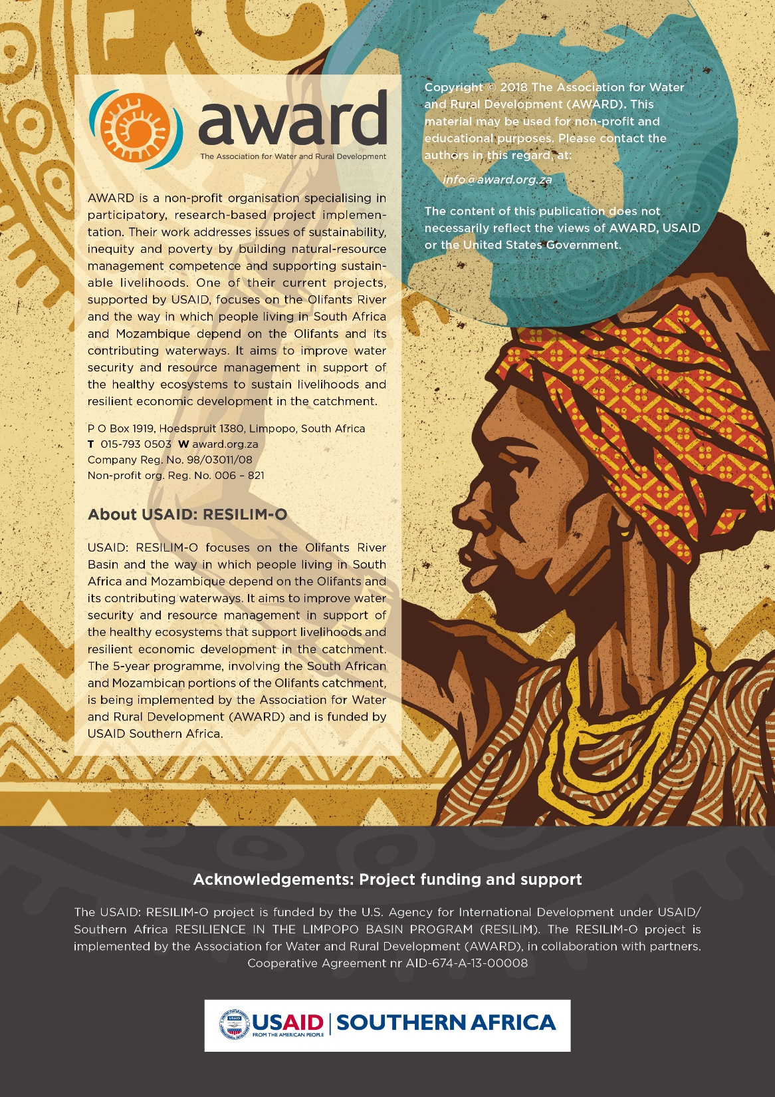
Acknowledgements: Project funding and support
The USAID: RESILIM-O project is funded by the US Agency for International Development under USAID/Southern Africa RESILIENCE IN THE LIMPOPO BASIN PROGRAM (RESILIM). The RESILIM-O project is implemented by the Association for Water and Rural Development (AWARD), in collaboration with partners.
Cooperative Agreement nr AID-674-A-13-00008

